Slide 1

Topic: Adding and Subtracting with negative numbers
EQ: How do we add and subtract with negatives?
Mrs. McLeod

Slide 2
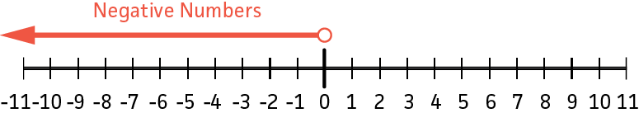
24
7
30
Topic: Adding and Subtracting with negative numbers
Date
EQ: How do we add and subtract with negatives?
Negative numbers
On the left of zero on the number line, increase in value as you get farther away from zero
Is zero positive or negative? Have a think, check with your shoulder partner
Sum
Plus
Increase
Total
More
Neither!
Other words
for addition
Can you think of anymore?

Slide 3
24
7
30
Topic: Adding and Subtracting with negative numbers
Date
EQ: How do we add and subtract with negatives?
Is a number has NO sign we can assume it is a positive number
3 is positive +3
No sign
Adding/subtracting a positive
Normal addition 2 + 3 = 5
Normal subtraction 6 - 2 = 4
Subtracting a positive is the same as adding a negative!
Adding negative value so we are going down the number line
6 + -2 = 4
Adding a negative
Subtracting a negative
Subtracting negative value
6 - -2 = 8
Which is the same as 6 + 2 = 8
Two negatives make a positive!

Slide 4
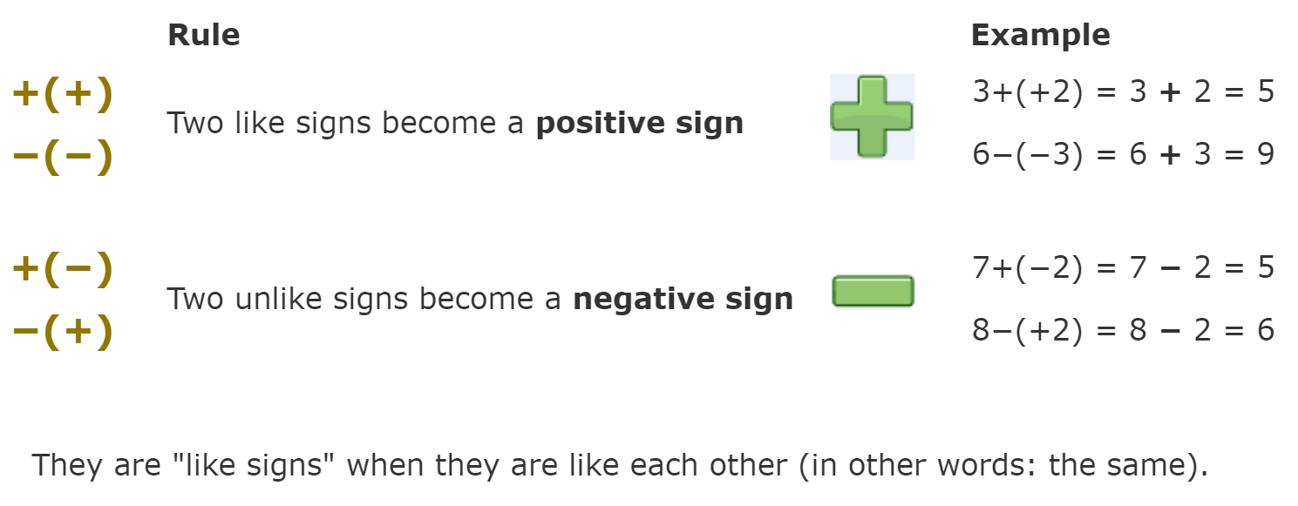
24
7
30
Topic: Adding and Subtracting with negative numbers
Date
EQ: How do we add and subtract with negatives?
Rule

Slide 5
https://youtu.be/DBSviXhkubg

Slide 6
24
7
30
Topic: Adding and Subtracting with negative numbers
Date
EQ: How do we add and subtract with negatives?
From the video can you write the steps for following the trick in your own words?
Share with a partner
Trick

Slide 7

Practice
3 + 6 =
2 + -5 =
3 - 6 =
5 + -3 =
-3 - 5 =
-4 + -3 =
4 - -3 =
-2- -6 =

Slide 8



Shark Boat

